Slide 1
TIME VS YOU
By:
Akshay Dalal
Ayush Kumar Jain
Shiv Kumar
Shubham Pathak

Slide 2
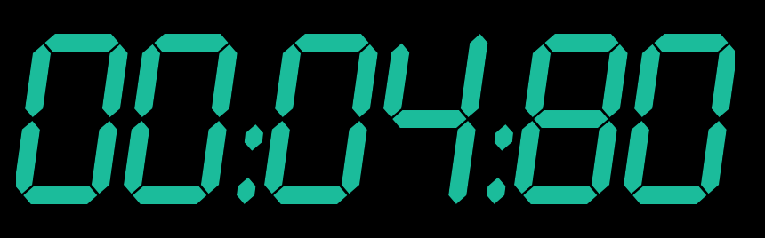
Introduction:
It is a game that TESTS YOUR HAND-EYE COORDINATION
It has been made in PYTHON
Controls:
  Numpad 1-9
  SPACE
The can pretty much help you improve your reflexes.
It is a game that TESTS YOUR HAND-EYE COORDINATION
It has been made in PYTHON
Controls:
  Numpad 1-9
  SPACE
The can pretty much help you improve your reflexes.

Slide 3
Rules of the game
You need to choose your favourite colour among several colours
There is a grid of 3x3, corresponding to 9 numbers of Numpad
Your favourite colour is going to appear in one of the squares.
you have to press the key corresponding to that before it disappears.

Slide 4
Rules of the game(contd.)
Throughout the game you have to maintain a threshold score which increases with time.
The movement of the square becomes faster with time see how long you can play the game.
All The Best

Slide 5
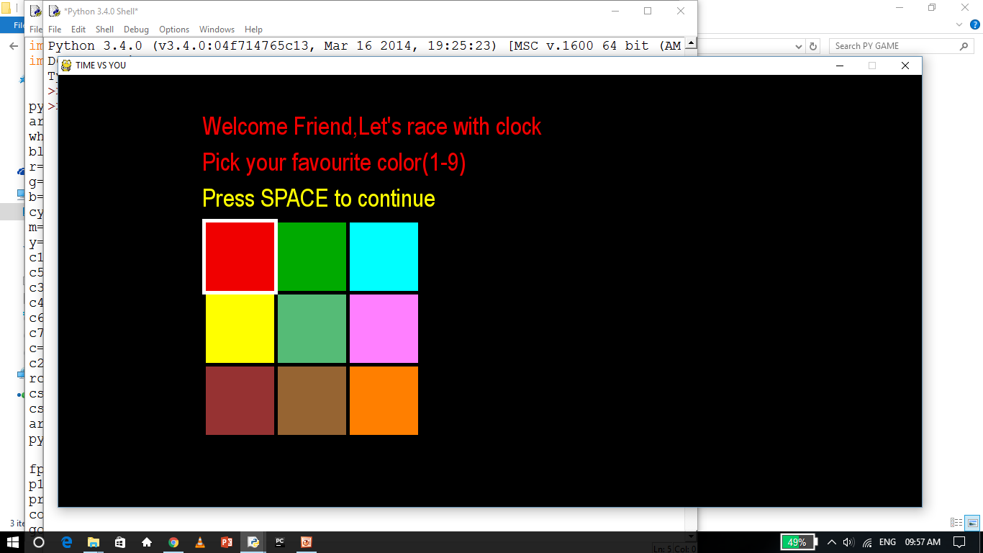
SCREEN SHOTS

Slide 6
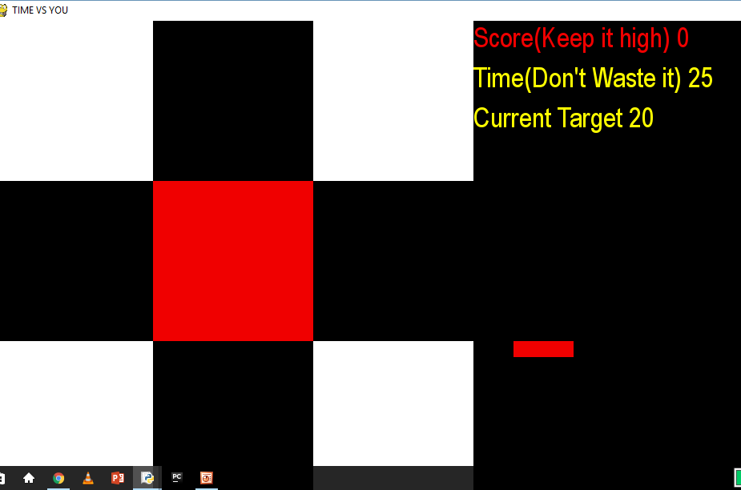
SCREEN SHOTS

Slide 7
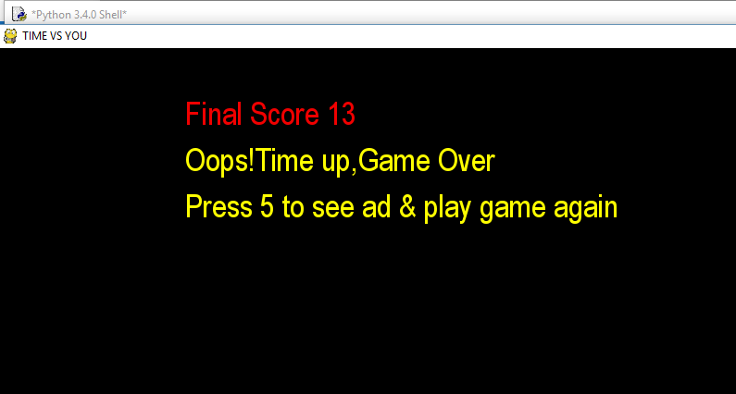
SCREEN SHOTS

Slide 8
Used In The Game
The game has been made in PYTHON
pygame module has been used
It also contains a sound in background (mp3 file)
an Image containing our names(jpg file)
Random for random appearance of square

Slide 9
A Game By:
Guided By:
Prof. Rizwaan Ur Rehman
Ayush Kumar Jain-(151112068)
Akshay Dalal-(151112071)
Shiv Kumar-(151112109)
Shubham Pathak-(151112060)

